Slide 1

"Hire Me or Not? Image Classifier Fun"
by Susy Costa
2023

Slide 2
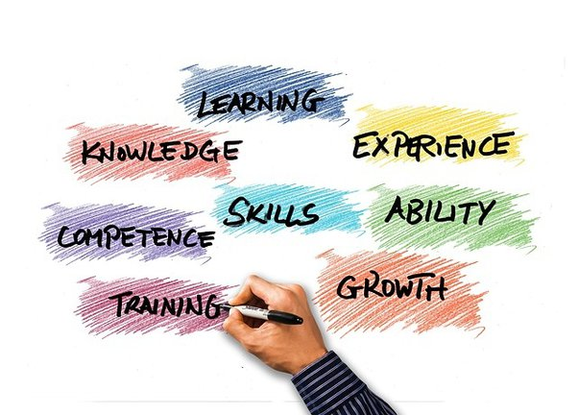
WHAT’S THE GOAL
Create a fun web tool that, through a model, playfully evaluates:
job skills through image classification
Creates fun, skill-based suggestions
encourages users to share their unique strengths on social media

Slide 3

SKILLS KEY ASPECTS
excel in endeavors
fostering adaptability
problem-solving
personal growth.

Slide 4
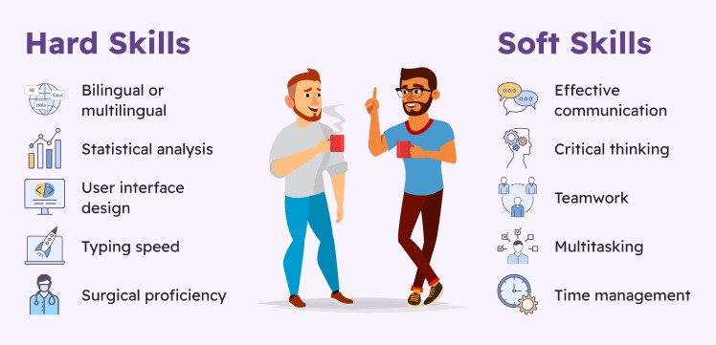
MAIN SKILL CATEGORIES
Hard skills are quantifiable and teachable capabilities, often gained through education or experience and they are specific and job-related.
Hard skills are quantifiable and teachable capabilities, often gained through education or experience and they are specific and job-related.
SOFT SKILLS
Interpersonal qualities that enhance effectiveness in work and social settings, contributing to overall success and collaboration.
HARD SKILLS
Hard skills are quantifiable and teachable capabilities, often gained through education or experience and they are specific and job-related.

Slide 5
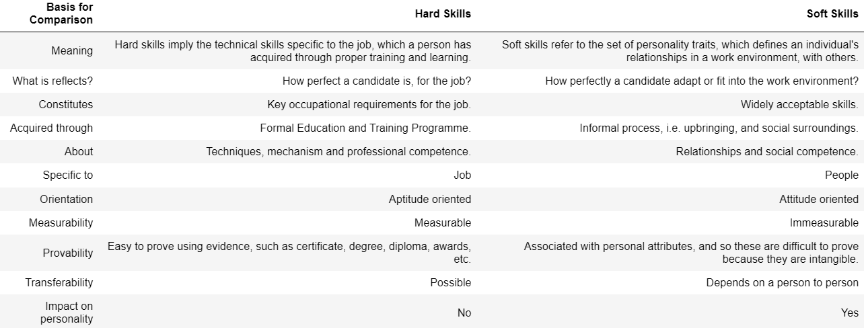
BASIS FOR COMPARISON

Slide 6
EUROPEAN SKILL RANK
Skills Development
Skills Activation
Skills Matching
how effectively people in a country are enhancing their skills
how close a country is to the best skill development
how effectively people use their skills in real life
how near a country is to the best skill activation
examines if people's skills match what the job market needs
how well a country aligns skills with job market requirements

Slide 7

LET’S
PLAY
THE GAME!

Slide 8

THANK YOU!

